Slide 1
Informatica PowerCenter
Lesson 1- Informatica PowerCenter

Slide 2
Lesson Objectives
In this lesson you will learn about:
  What is a Data Warehouse ?
  Overview of Data Warehouse Model
  ETL Process
  Informatica PowerCenter Components
  PowerCenter Domain
  Integration Service
  Repository Manager
  User and Group Management
  Folder

Slide 3
1.1: Data Warehouse
What Is A Data Warehouse ?
A Data Warehouse is an enterprise-scale database that has been derived from one or more sources
It is intended for end-user decision support
Allows us to move information from multiple sources into a common target area, that managers and decision makers are able to access through reporting tools
This also serves to relieve the operational sources from query time
Notes:
A data warehouse is a decision support database that is maintained separately from an organization’s operational databases. It usually resides on a dedicated server. This database is designed based on what kind of information a company is seeking (e.g., sales, marketing, healthcare membership and providers, etc.). A data warehouse is “the place” for top executives, managers, analysts, and other end-users to mine a rich source of company information. They can ask compelling business questions and find answers in their data, and make key and timely business decisions from their desktops using GUI based On-line Analytical Processing (OLAP) tools.

Slide 4
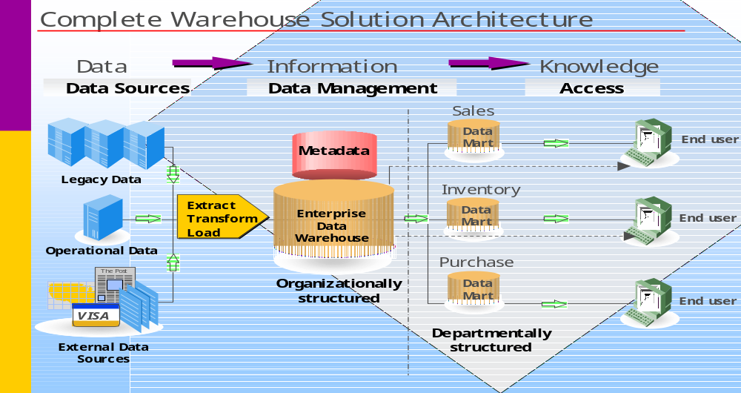
1.2:Overview
Data Warehouse Model
Figure 1.1
Notes:
The above Figure 1.1. shows a simplified data warehouse model. The developer puts business rules for data transformation into the metadata repository. There is a transformation process that extracts data from the operational sources like database, legacy systems, and flat files. It transforms data according to the business rules, and loads the data into the data warehouse. From the data warehouse, atomic data flows to various departments for their customized usage. These departmental databases are called data marts.
The end user will use a query tool to look at the metadata in the repository and the transformed data in the warehouse. The data in the data warehouse will be used to cater to dynamic and complex reporting requirements.
When Informatica’s PowerCenter is fit into the above model, the developer can use PowerCenter Designer tool to develop mappings and other metadata for the Informatica repository.

Slide 5
1.3:ETL Process
ETL Process
Use ETL Process to build a Data Warehouse
Extract
Extract data from various data sources
Data validation
Apply business rules
Transform
Load
Load the data
PowerCenter is a product from Informatica used to perform ETL operation
Notes:
To populate the data in the data warehouse, the steps are:
Extract - Extracting appropriate data from existing operational database(s), flat files etc
Transform - Cleansing or scrubbing the data, aggregating, denormalizing and filtering the data
Load - Loading the data into the database
This data population process is also known as the data transformation process. Moving data from the operational databases to the data warehouse needs to be done via extraction tools. Operational data needs to be mapped to the target data warehouse. As a part of the data movement, data transformation is performed as specified by the meta data rules developed during the data modeling stage. PowerCenter is a product from Informatica used to perform ETL operation.

Slide 6
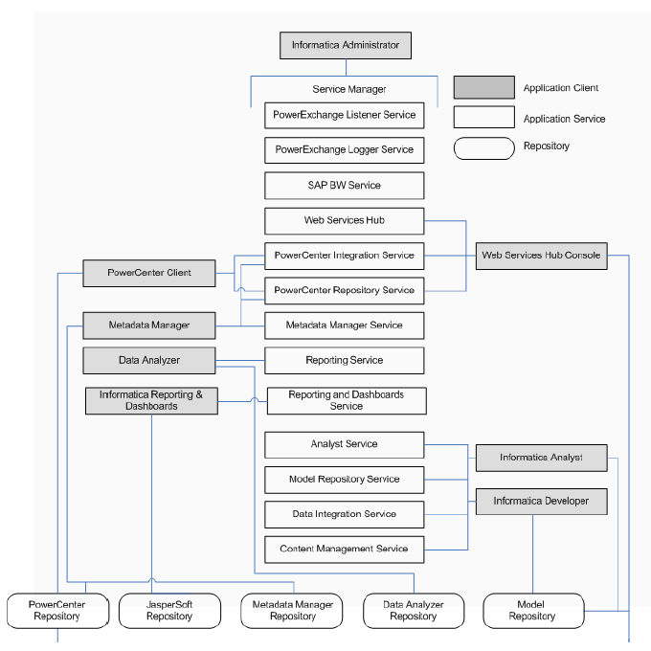
Informatica 9.5.1 Architecture

Slide 7
1.4:Informatica Power Center
Components
Power Center includes the following components:
  Power Center domain
  Power Center repository
  Administration Console
  Power Center Client
  Repository Service
  Integration Service
  Web Services Hub
  SAP BW Service
  Reporting Service
  Data Analyzer
  Metadata Manage
  Power Center Repository Reports
Notes:
PowerCenter provides an environment that allows to load data into a centralized location, such as a datamart, data warehouse, or operational data store (ODS). Data can be extracted from multiple sources, transformed according to business logic built in the client application, and load the transformed data into file and relational targets. Informatica provides the following integrated components:
PowerCenter domain. The Power Center domain is the primary unit for management and administration within PowerCenter. The Service Manager runs on a PowerCenter domain. The Service Manager supports the domain and the application services.
PowerCenter repository. The PowerCenter repository resides in a relational database. The repository database tables contain the instructions required to extract, transform, and load data
Administration Console. The Administration Console is a web application that you use to administer the PowerCenter domain and PowerCenter security
PowerCenter Client. The PowerCenter Client is an application used to define sources and targets, build mappings and mapplets with the transformation logic, and create workflows to run the mapping logic. The PowerCenter Client connects to the repository through the Repository Service to modify repository metadata.
Repository Service. The Repository Service accepts requests from the PowerCenter Client to create and modify repository metadata and accepts requests from the Integration Service for metadata when a workflow runs
Integration Service. The Integration Service extracts data from sources and loads data to targets

Slide 8
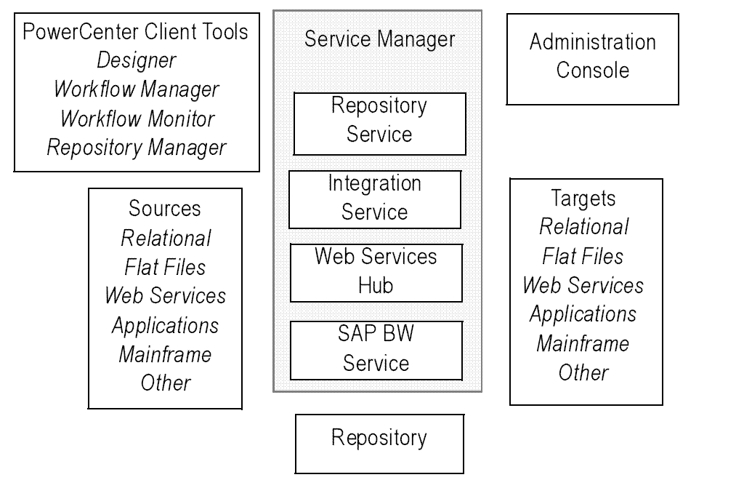
1.4:Informatica Power Center
Components
Figure 1.2
Notes:
Sources
PowerCenter accesses the following sources:
Relational: Oracle, Sybase ASE, Informix, IBM DB2, Microsoft SQL Server, and Teradata.
File: Fixed and delimited flat file, COBOL file, XML file, and web log.
Application: Business sources such as Hyperion Essbase, WebSphere MQ, IBM DB2 OLAP Server, JMS, Microsoft Message Queue, PeopleSoft, SAP NetWeaver, SAS, Siebel, TIBCO, and webMethods.
Mainframe: Mainframe databases such as Adabas, Datacom, IBM DB2 OS/390, IBM DB2 OS/400, IDMS, IDMS‑X, IMS, and VSAM.
Other: Microsoft Excel, Microsoft Access, and external web services.
Targets
PowerCenter can load data into the following targets:
Relational: Oracle, Sybase ASE, Sybase IQ, Informix, IBM DB2, Microsoft SQL Server, and Teradata.
File: Fixed and delimited flat file and XML.
Application: Business sources such as Hyperion Essbase, WebSphere MQ, IBM DB2 OLAP Server, JMS, Microsoft Message Queue, mySAP, PeopleSoft EPM, SAP BW, SAS, Siebel, TIBCO, and webMethods.
Mainframe: Mainframe databases such as IBM DB2 for z/OS, IMS, and VSAM.
Other: Microsoft Access and external web services.

Slide 9
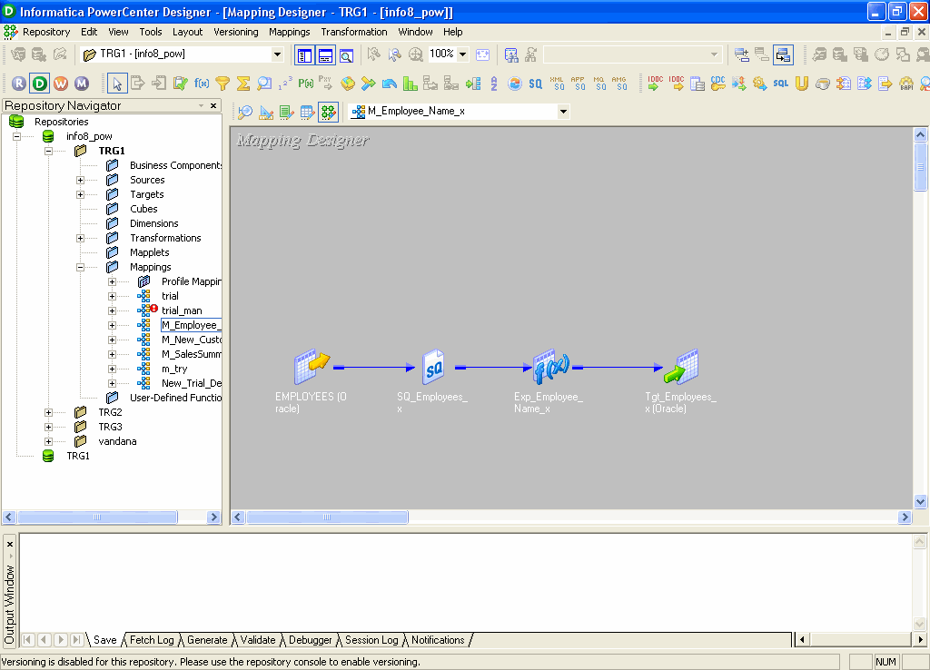
1.4:Informatica Power Center
Power Center Designer
Figure 1.3
Notes:
The PowerCenter Designer has five tools to build mappings and mapplets so as to specify how to move and transform data between sources and targets.
The five tools are as follows:
Source Analyzer
Target designer
Transformation Developer
Mapplet Designer
Mapping Designer
The Designer helps create source definitions, target definitions, and transformations to build the mappings.
The Designer allows to work with multiple tools at one time and to work in multiple folders and repositories at the same time. It also includes windows so as to view folders, repository objects, and Tasks.

Slide 10
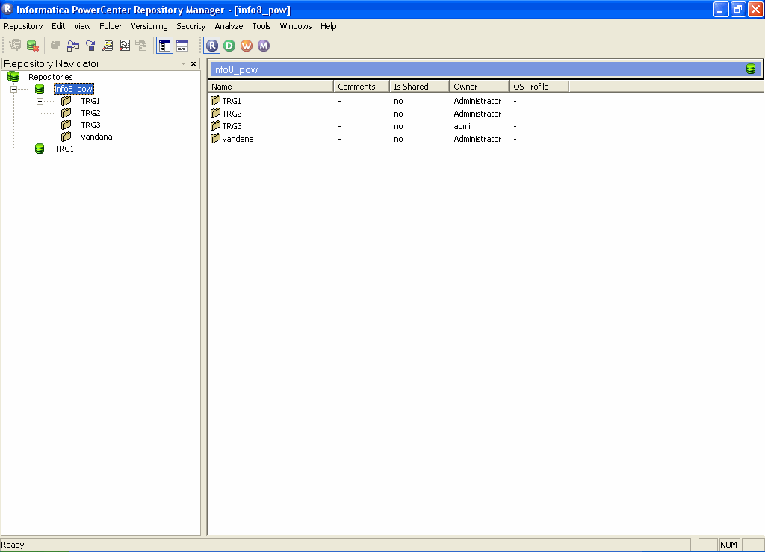
1.4:Informatica Power Center
Power Center Repository Manager
Figure 1.4
Notes:
The Repository Manager client tool allows to navigate through multiple folders and repositories and perform basic repository Tasks. The Repository Manager can be used to:
Add a repository
Remove a repository
Connect to a repository
Search for repository objects, etc.

Slide 11
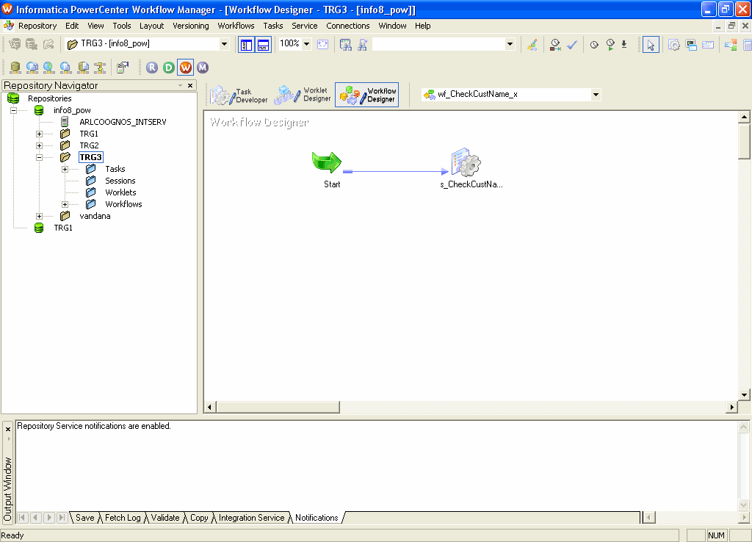
1.4:Informatica Power Center 8.5
Power Center Workflow Manager
Figure 1.5
Notes:
The Workflow Manager is used to define a set of instructions called a Workflow to execute mappings built in the Designer. Generally, a Workflow contains a session and any other Task to be performed when a session is executed.

Slide 12
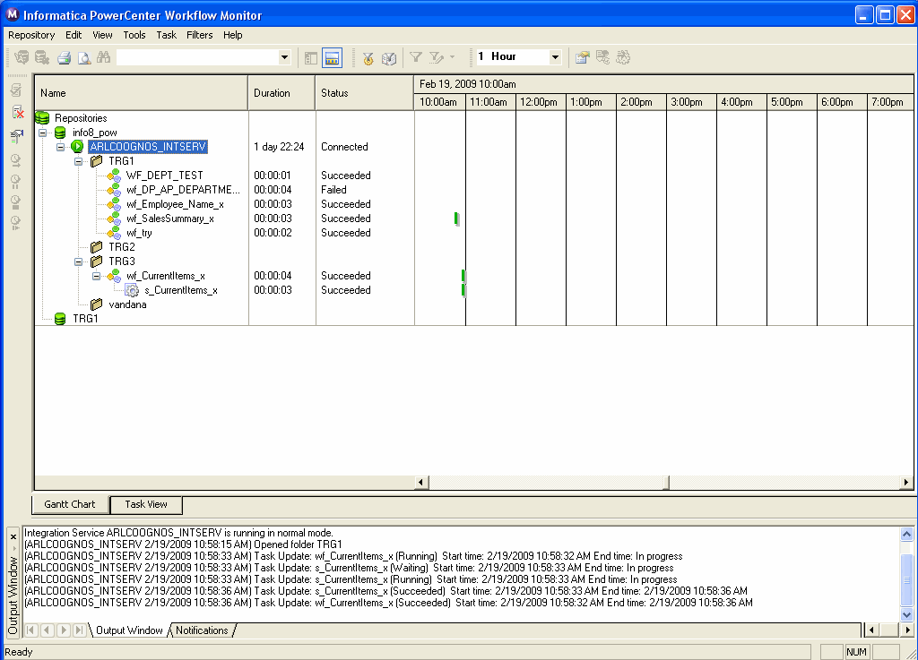
1.4:Informatica Power Center
Power Center Workflow Monitor
Figure 1.6
Notes:
The Workflow Monitor is a tool that allows to monitor data loading process.

Slide 13
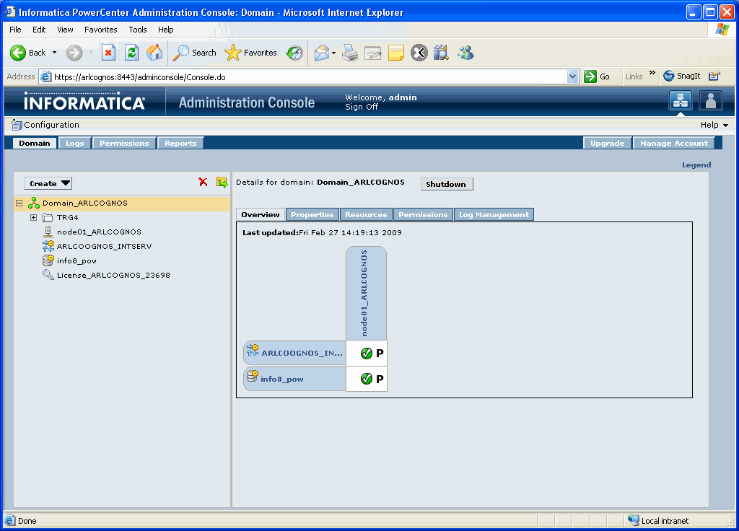
1.4:Informatica PowerCenter
PowerCenter Administration Console
Figure 1.7
Notes:
The PowerCenter Administration Console is the administration tool you use to administer the PowerCenter domain and PowerCenter security. Use the Administration Console to perform the following tasks:
Domain administrative tasks. Manage logs, domain objects, user permissions, and domain reports. Domain objects include services, nodes, grids, folders, and licenses.
Security administrative tasks. Manage users, groups, roles, and privileges.

Slide 14
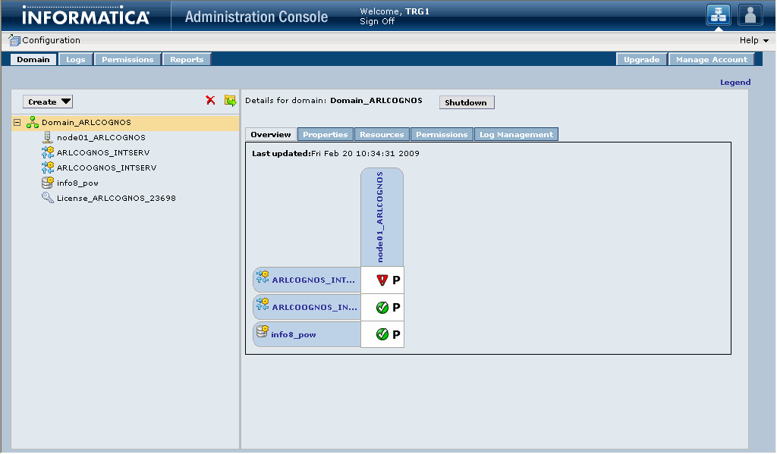
1.5:PowerCenter domain
Introduction
Figure 1.8
Notes:
A domain is the primary unit for management and administration of services in PowerCenter. PowerCenter provides the PowerCenter domain to support the administration of the PowerCenter services.

Slide 15
1.6:Integration Service
Introduction
The Integration Service moves data from sources to targets based on workflow and mapping metadata stored in a repository.
When a workflow starts, the Integration Service retrieves mapping, workflow, and session metadata from the repository.
It extracts data from the mapping sources and stores the data in memory while it applies the transformation rules configured in the mapping.

Slide 16
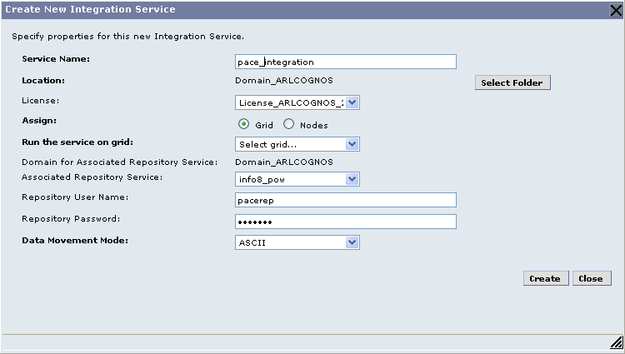
1.6:Integration Service
Creating Integration Service
Figure 1.10
Notes:
Steps to Create Integration Service:
In the Administration Console, click Create > Integration Service.
The Create New Integration Service dialog box appears.
Enter values for the following Integration Service options Service Name, Location, License, Assign, Run the Service on Grid, Primary Node, Backup Nodes, Domain for Associated Repository Service, Associated Repository Service, Repository User Name, Repository Password, Security Domain, Data Movement Mode
Click OK.
If you do not specify an associated repository, the following message appears:
No Repository Service is associated with this Integration Service. Select an associated Repository Service to view a list of available codepages.
You cannot enable the Integration Service until you assign the code page for each Integration Service process node.
Click OK.

Slide 17
1.6:PowerCenter Interface
Demo
Notes:
PowerCenter Graphical User Interface

Slide 18
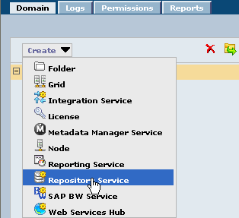
1.7:Repository Manager
Creating Repository Service
Open PowerCenter Administration Console and then click on Domain->Create from the drop down list select Repository Service
Figure 1.12

Slide 19
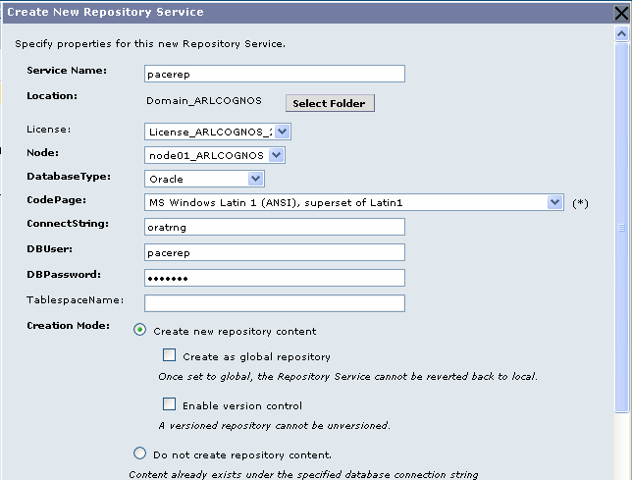
1.7:Repository Manager
Creating Repository Service
Enter the properties of the Repository Service
Figure 1.13

Slide 20
Demo
Notes:
Following are the steps to create a repository:
In the Navigator of the Administration Console, select the folder where you want to create the Repository Service.
Note: If you do not select a folder, you can move the Repository Service into a folder after you create it.
2. Click Create > Repository Service.
The Create New Repository Service dialog box appears.
3. Enter values for the following Repository Service options:
Service Name, Location, License, Node, Database Type, CodePage, ConnectString, DBUser, DBPassword, TableSpaceName, Creation Mode
4. If you create a Repository Service for a repository with existing content and the repository existed in a
different PowerCenter domain, verify that users and groups with privileges for the Repository Service exist in the current domain.
5. Click OK.
The created repository service will be seen in the folder. Then select the Repository Service in Navigator window and then the repository service can be enabled or disabled using Enable or Disable

Slide 21
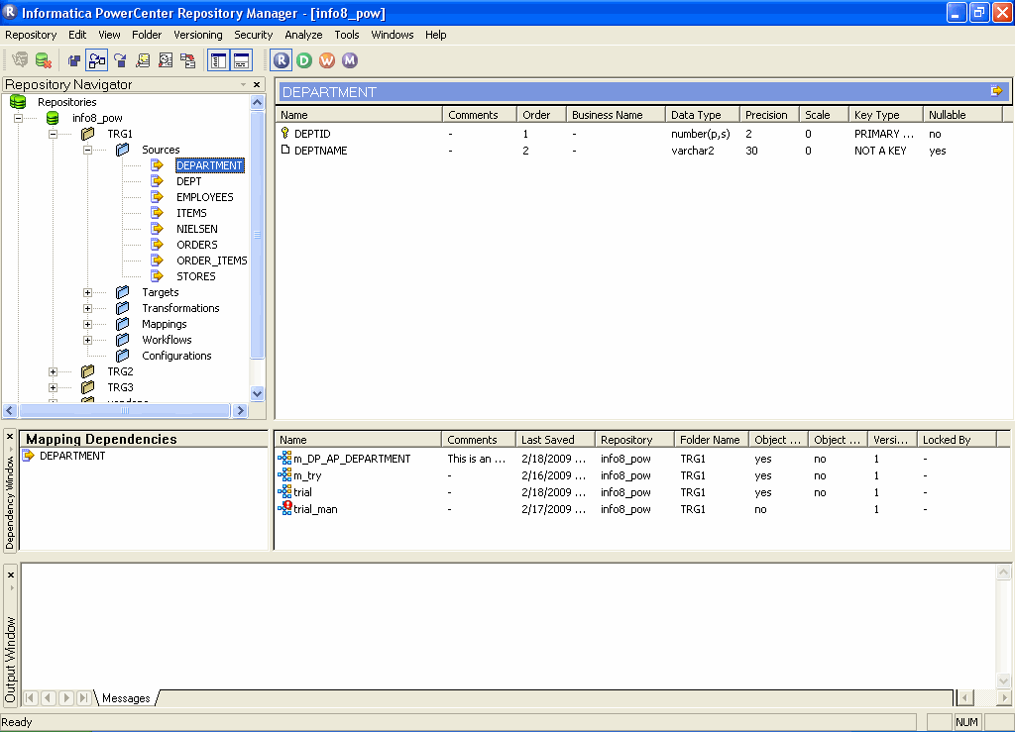
1.7:Repository Manager
Creating Repository Service
Navigator Window
Main Window
Dependency Window
Output Window
Figure 1.14
Notes:
The Repository Manager allows to perform basic repository tasks. It has the following four windows:
Navigator Window - Displays all the objects that are created in the Repository Manager, the Designer, and the Workflow Manager. It is organized first by repository, then by folder.
Main Window - Provides properties of the object selected in the Navigator window. The columns in this window will change depending upon the object selected in the Navigator window.
Dependency Window - Shows dependencies on sources, targets, mappings, and shortcuts for objects selected in either the Navigator or Main window
Output Window - Provides the output of procedures executed within Repository Manager
Other Tasks that can be performed within the Repository Manager include:
Create folders and edit folder properties
Establish users, groups, privileges, and edit folder permissions
Search metadata and perform dependency analyses
View locks and unlock objects

Slide 22
Demo
Notes:
Steps to connect to the repository using Repository Manager for the first time:
Launch the Repository Manager tool, choose Start | Programs | Informatica PowerCenter | Client | Repository Manager.
Click on the Add Repository menu option.
Enter the following information:
Repository name
Username
5. Choose Repository | Connect or right click on the repository name and choose Connect.
6. The Connect to Repository dialog box appears.
7. Enter the repository username and password.
8. Click More.
9. The Connect to Repository dialog box expands.
10. Enter the host name of the machine the Repository Server is running on and the port number the Repository Server uses for connections.
11. Click Connect.

Slide 23
1.8:User and Group Management
Introduction
To access the services and objects in the Power Center domain and to use the Power Center applications, you must have a user account.
The tasks you can perform depend on the type of user account you have.
User account management in Power Center involves the following key components:
  Users. You can set up different types of user accounts in the Power Center domain.

Slide 24
1.8:User and Group Management
Introduction
Groups. You can set up groups of users and assign different roles, privileges, and permissions to each group.
Privileges and Roles. Privileges determine the actions that users can perform in PowerCenter applications.
A role is a collection of privileges that you can assign to users and groups.
Authentication. When a user logs in to PowerCenter, the Service Manager authenticates the user account in the PowerCenter domain and verifies that the user can use the PowerCenter applications.

Slide 25
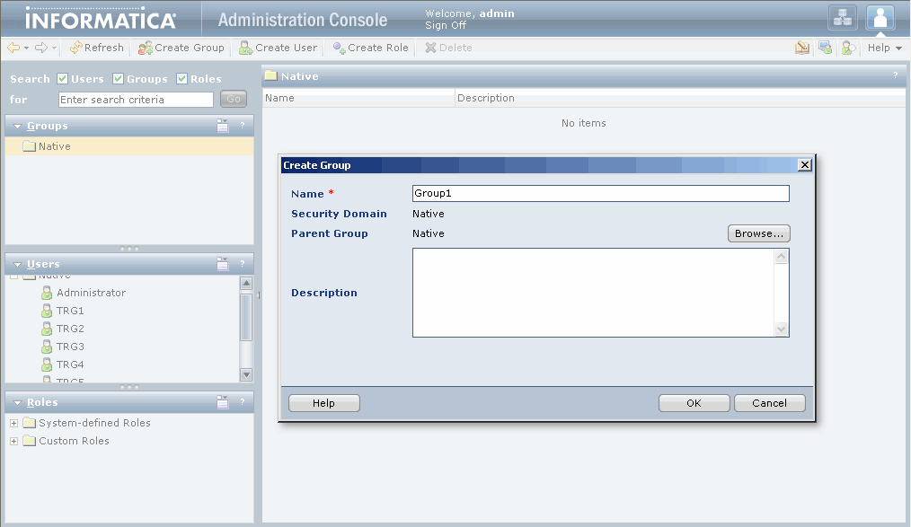
1.8:User and Group Management
Creating Group
Figure 1.15
Notes:
The steps for creating a group are as follows:
In the Administration Console Screen, Select Configure Security
Select Create Group
Enter Name and Description
Browse and select the Group in case of creating sub grouping

Slide 26
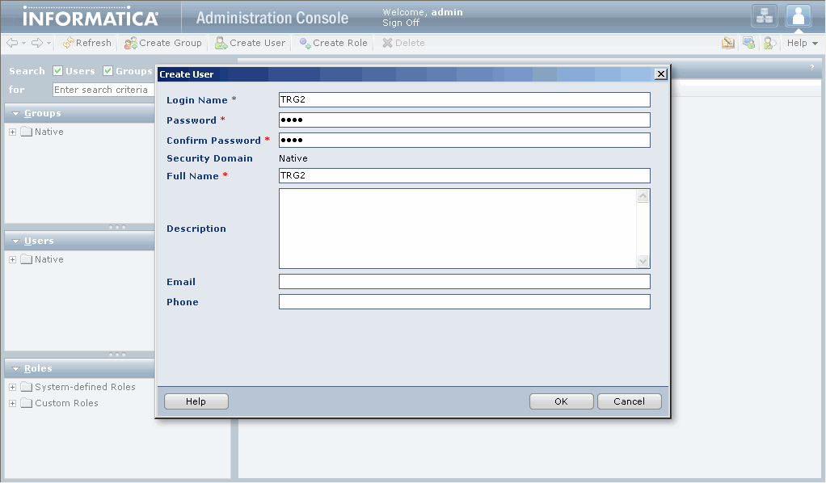
1.8:User and Group Management
Creating User
Figure 1.16
Notes:
The steps for creating a user are as follows:
In the Administration Console Screen, Select Configure Security
Select Create User
Enter Name, Password, Full Name, Description, Email, Phone
Click OK

Slide 27
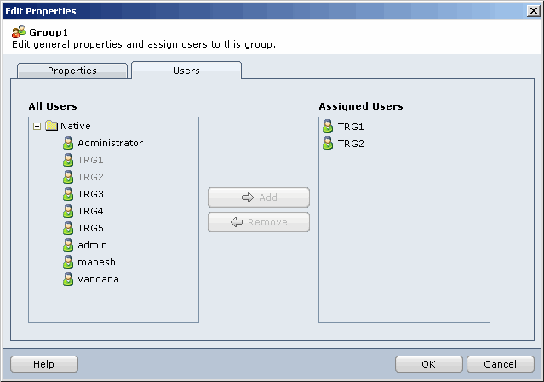
1.8:User and Group Management
Assigning Users To Group
Figure 1.17
Notes:
The steps for Assigning the Users to the Group are as follows:
Select the Group from Navigator Window
Overview|Edit |Users
Add the users to the group

Slide 28
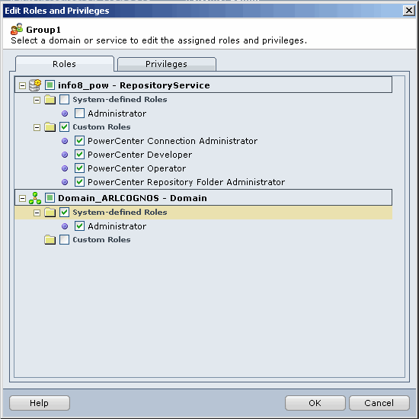
1.8:User and Group Management
Assigning Roles And Privileges
Figure 1.18
Notes:
The steps for Assigning the Roles to the Group are as follows:
Select Group from Navigator Window
Overview|Edit |Roles
Select the Appropriate Roles from:
System-Defined Roles
Custom Roles
Press OK
The steps for Assigning the Privileges to the Group are as follows:
Select Group from Navigator Window
Overview|Edit |Privileges
Select the appropriate privileges from:
Tools: Includes the privilege to log in to the Administration Console.
Security Administration: Includes privileges to manage users, groups, roles, and privileges.
Domain Administration: Includes privileges to manage the domain, folders, nodes, grids, licenses, and application services.
Press OK

Slide 29
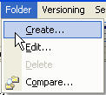
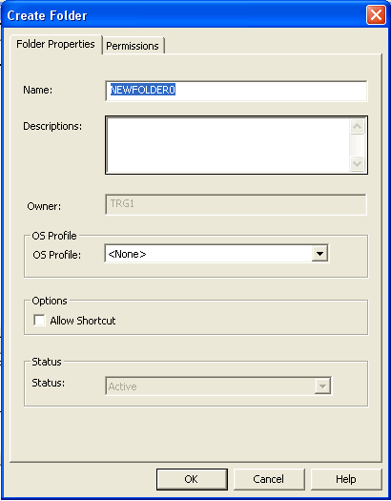
1.9:Folder
Introduction
Folders provide a way to organize and store all metadata in the repository
Create a folder in a repository before connecting to the repository using the Designer or Workflow Manager
Figure 1.19
Notes:
Folders provide a way to organize and store all metadata in the repository, including mappings, schemas, and sessions. Folders are designed to be flexible, to logically organize the repository. Each folder has a set of configurable properties that helps to define how users access the folder. For example, create a folder that allows all repository users to see objects within the folder, but not to edit them. Or, create a folder that allows users to share objects within the folder.
Folder Attributes
FOLDER OWNER - User who serves as focal point to folder permissions
PERMISSIONS - Rights to read, write, and/or execute objects in a folder
SHARED - Property that allows users to make shortcuts in a folder
SHORTCUT - A dynamic link to an object stored in a shared folder
VERSIONS - Folder iterations that indicate development stages
A folder can be designated as shared by checking ‘Allow Shortcuts’ in the Folder Properties. When a folder is shared, users can create shortcuts to objects in the folder, thereby sharing the metadata in the folder. Once a folder is designated as shared, it cannot be reverted back to make it non-shared. If a folder is not shared, users will only be able to make copies of objects in the folder.

Slide 30
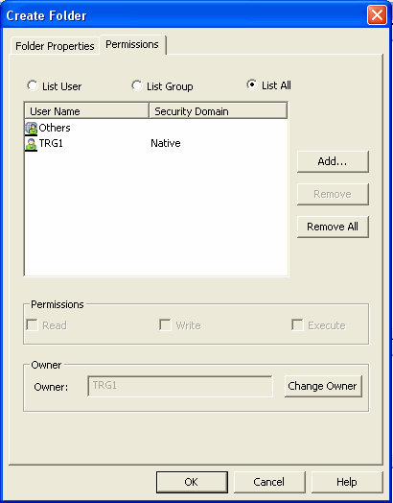
1.9:Folder
Folder Permissions
Permissions
  Read permission
  Write permission
  Execute permission
Figure 1.20
Notes:
Permissions
Allows repository users to perform Tasks within a folder. To perform Tasks within a folder having the privilege to perform the Task in the repository as well as the applicable folder permission is a must. The available folder permissions are:
Read permission - Allows to view the folder as well as objects in the folder
Write permission - Allows to create or edit objects in the folder
Execute permission - Allows to execute or schedule a Workflow in the folder
Note: Permissions work in conjunction with privileges. Privileges are actions that a user performs in PowerCenter applications. A user with the privilege to perform certain actions can require permissions to perform the action on a particular object.

Slide 31
1.9:Folder
Folder Permissions
Folder permissions can be granted on three levels of security.
  List User: User of the folder.
  List Group: Users of a particular group.
  List All: All the user belonging to repository services.

Slide 32
1.9:Creating Folders
Demo
Notes:
Steps to create a Folder:
In the Repository Manager, connect to the repository.
Choose Folder | Create.
Choose Folder Properties
Enter the following information:
Name – Folder name, Required.
Description - Description of the folder, Optional.
Owner - Owner of the folder. Any user in the repository can be the folder owner, Required.
Allow Shortcut - If selected, makes the folder shared, Optional
5. Choose Permissions Tab
Select the Radio Button from List User, List Group, List All
Then select Permission check boxes accordingly

Slide 33
Summary
After completing this lesson you now:
  Understand the ETL Process
  Know the role of PowerCenter ETL tool in a Data warehouse model
  Know the various components of PowerCenter
  Know your work environment in terms of a Repository, Users, and Folders

Slide 34
Review Question
Question 1: The three levels of folder permissions are ______, ______ and ______
Question 2: Informatica Client, and Informatica Server connect to the repository through the __________
Question 3: One can start working in PowerCenter without having an assigned folder.
  True
  False
Question 4: The first step in setting up repository security is to establish groups and users.
  True
  False

